Slide 1
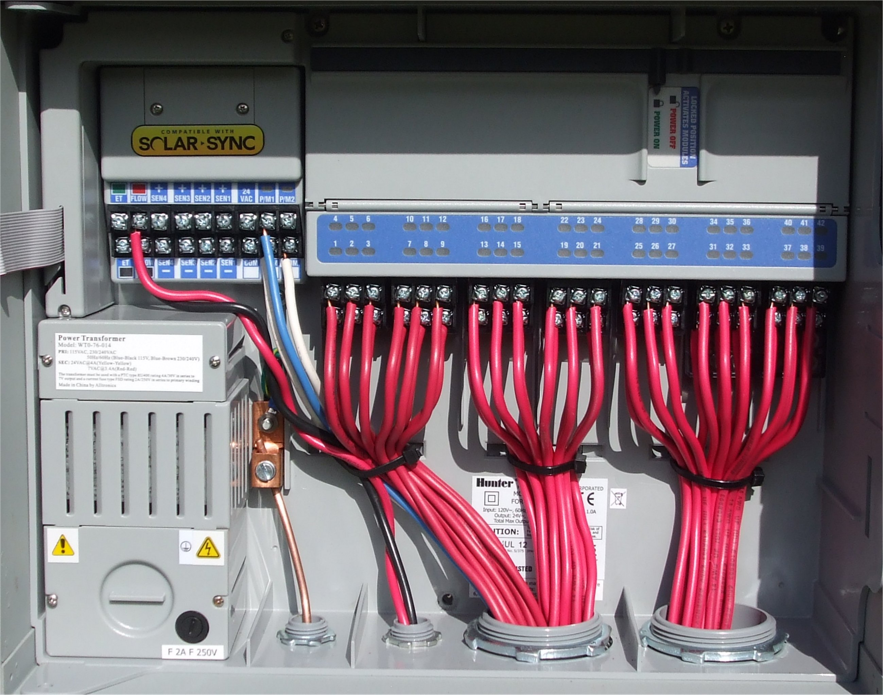
Installation

Slide 2
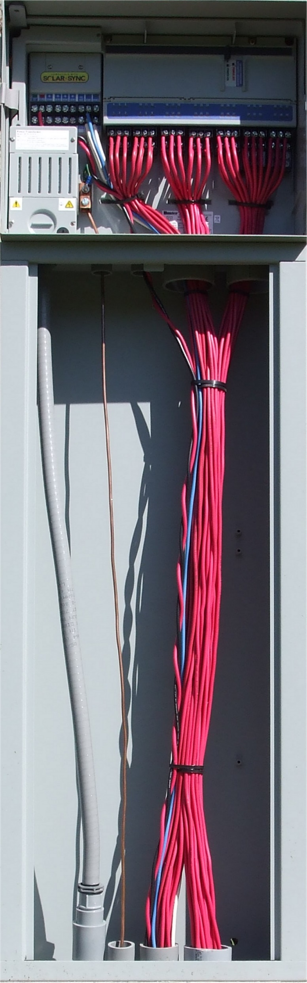
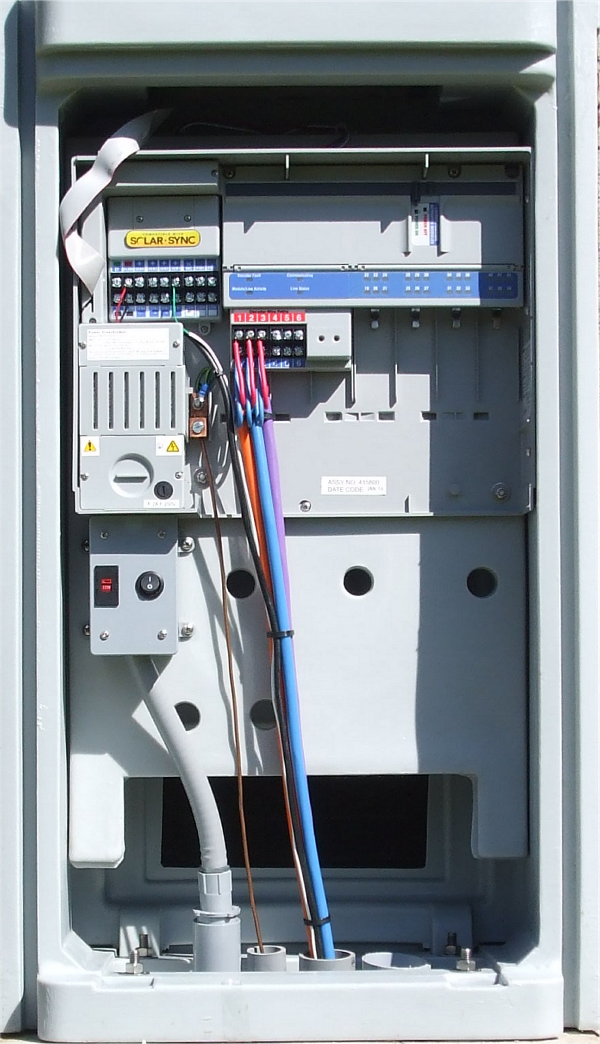

Slide 3
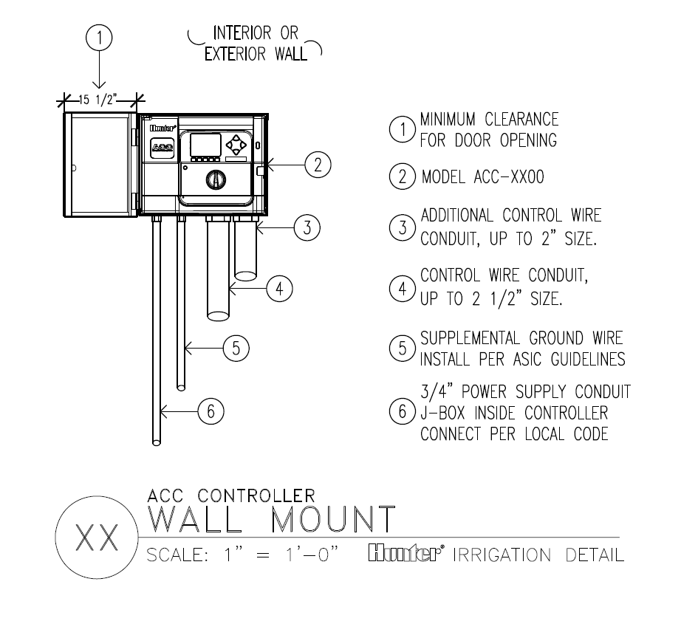

Slide 4
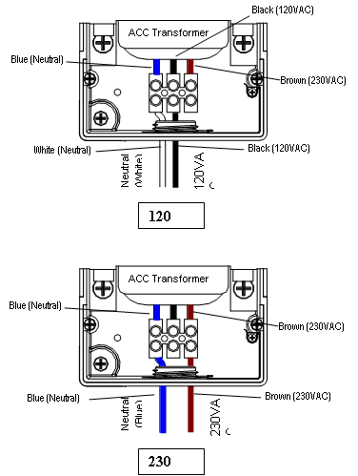
Transformer Wires
Black: 110V Hot, or Supply Wire
Blue: Neutral wire ( not Green wire)
Brown: 230V Hot, or Supply wire

Slide 5
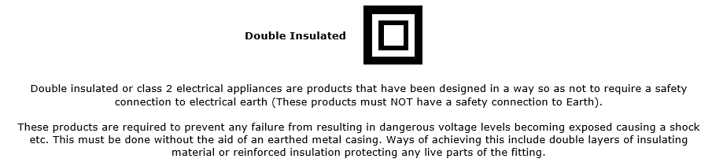
ACC is Double Insulated

Slide 6
The green, or green-and-yellow safety ground (service ground) is not required or permitted with this floating ground, double-insulated transformer.

Slide 7
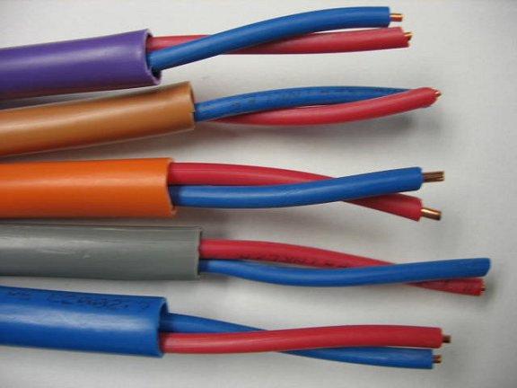
IDWIRE: Magic in the Wires
IDWire: Twisted, red/blue, direct burial in flexible colored jacket
Color coding for correct installation & tracing
Jacketed for better protection
Twisted-pair design provides:
  Greater surge resistance
  Greater tensile strength
  Resistance to electrical noise and crosstalk from AC wiring.

Slide 8
Installation Practices
Approved Waterproof Connections
Extra Wire at all Connections
All Connections in Boxes
All Grounding in Boxes

Slide 9
Installation Practices
Do not kink or crease the wire
Protect any exposed copper
Label all Decoders
Use the correct tool to remove wire jacketing
Do not pre-twist wire connections
Have your grounding tested
Do not loop 2WP, use multiple paths to controller

Slide 10
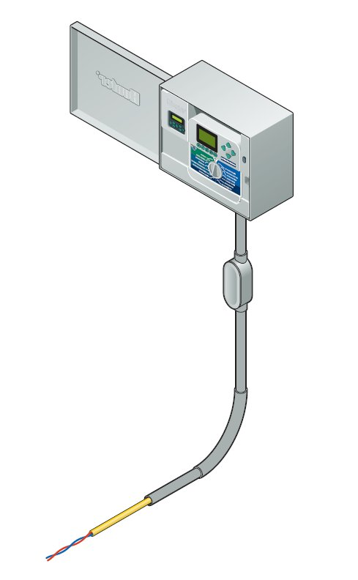
Up to 99 stations (and 2 Pump/Master Valve outputs)
A two-wire cable output is called a “path”.
All 99 decoder stations MAY be on a single path.
There are up to 6 paths available from the controller.
Use as many paths as you need, to reach all valves efficiently.
Paths do not need to be “looped” back to controller, or each other.
Path

Slide 11
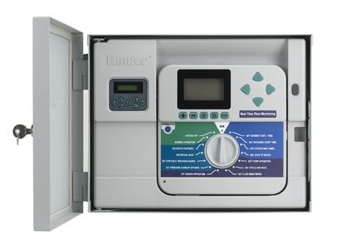
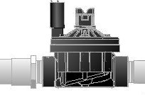
Planning Your Wire Paths
Place a decoder by each 24VAC valve (standard solenoids)
  A few solenoids with internal diodes or capacitors may not be decoder compatible, but most are
Max distance from controller to furthest decoder on each path:
  14 AWG: 10,000 ft. per path
  12 AWG: 15,000 ft. per path
Max distance from decoder to solenoid, 150 ft (recommended maximum)
  450 feet, theoretical max
= Decoder
= Earth Ground

Slide 12
Planning Your Wire Paths
Two-wire paths may be spliced!
346 Splices known to work
  Follow splice rules
  Use pipe trenches to route wire cheapest way
Use a different colored cable for each path.
Max wire distance applies to each wire path- from controller to each end of each run (10k/15k ft.)
= Decoder
= Earth Ground

Slide 13
Planning Your Wire Paths
Earth Ground every 12 decoders (minimum), or 1000’, whichever is sooner
- more in high-lightning areas (such as Florida)
Ground the end of each wire path (the last decoder)
Use 8’-10’ ground rods, or rectangular copper plates
= Decoder
= Earth Ground
Position ground hardware 8’-10’ away, at right angles to wire path
Hunter ICD decoders need no additional surge devices!

Slide 14
Decoders- the Flexible Choice for a Changing World
Decoders are only required as they are needed
It is possible to start at the furthest point, with the bare minimum number of decoders…
…as phased projects build out, add decoders, when you add the valves
If the plan is changed, just splice in another decoder
No additional programming at the controller, except to add a run time!

Slide 15
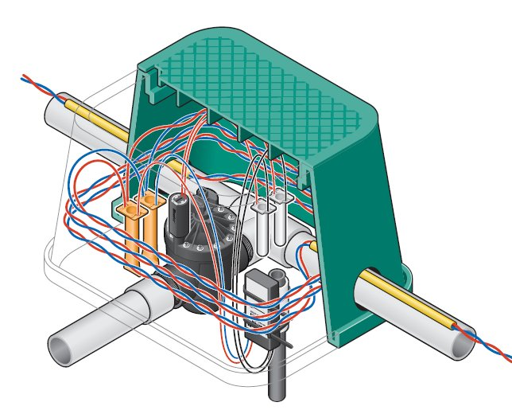
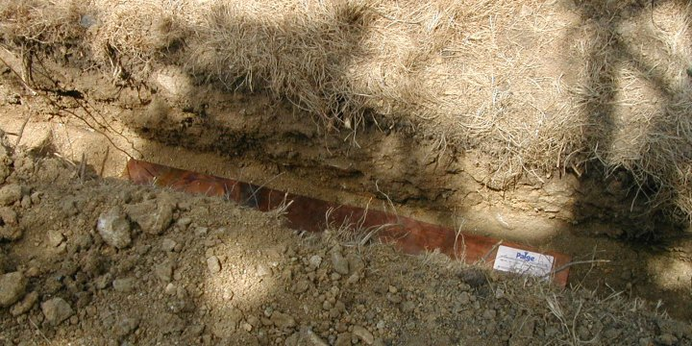
Installation Matters
DBR/Y-6 Waterproof connectors or equal, for all red/blue connections
  DBR-6 for larger wire tee connections
  DBx-6 connectors are UL listed to 600V
Decoder-to-solenoid with waterproof DBY or equal direct burial connections
All waterproof decoders in valve boxes – for future location and service
Earth Ground connections to 4” x 36” copper plate, or 8’-10’ rod
DBY-6

Slide 16
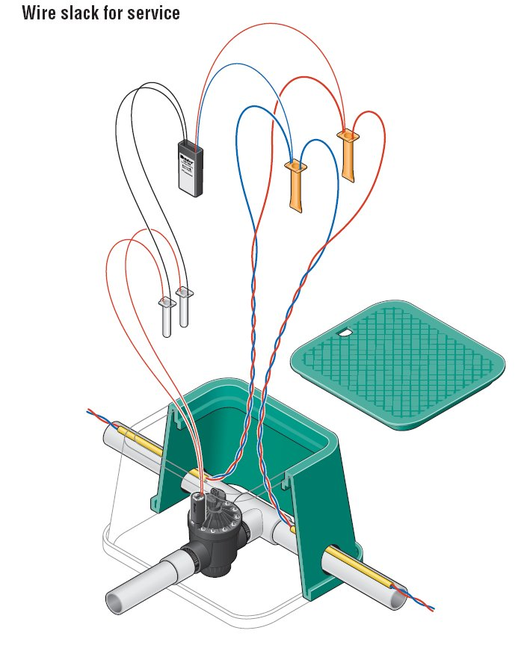
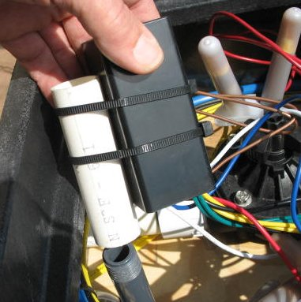
Cut us some slack…
5 feet slack wire, per splice
  At decoders, and at T splices
Always in a valve box
Stake decoder upside down (recommended)
Up to 150 feet from decoder to solenoid (shorter is better)

Slide 17
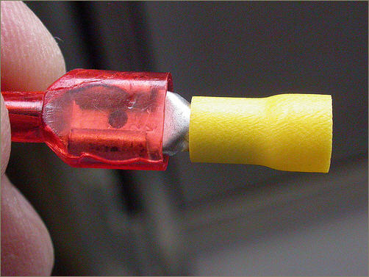
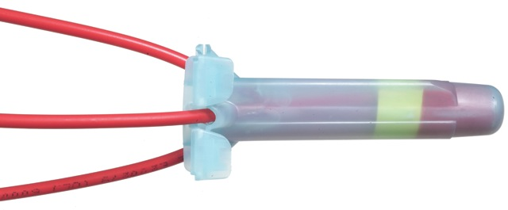
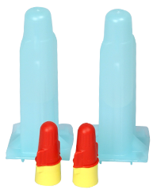
Splices

